Slide 1
Out with the Old,
In with the New
Amy Tan
28/10/2018

Slide 2
Key Scripture
Luke 5:33-39
³³ Then they said to Him, “Why do the disciples of John fast often and make prayers, and likewise those of the Pharisees, but Yours eat and drink?”
³⁴ And He said to them, “Can you make the friends of the bridegroom fast while the bridegroom is with them?
³⁵ But the days will come when the bridegroom will be taken away from them; then they will fast in those days.”

Slide 3
³⁶ Then He spoke a parable to them: “No one puts a piece from a new garment on an old one; otherwise the new makes a tear, and also the piece that was taken out of the new does not match the old.
³⁷ And no one puts new wine into old wineskins; or else the new wine will burst the wineskins and be spilled, and the wineskins will be ruined.
³⁸ But new wine must be put into new wineskins, and both are preserved.
³⁹ And no one, having drunk old wine, immediately desires new; for he says, ‘The old is better.’ ”
Notes:
This Scripture illustrates and clearly shows that mixture of old and new does not work. Translating this to our lives, that we cannot have a mixture of our old and new (future) lifestyle.
Also once you have experienced the new, you will never go back to the old.

Slide 4
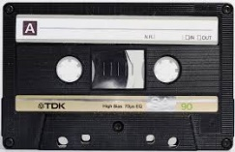

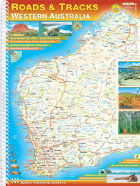
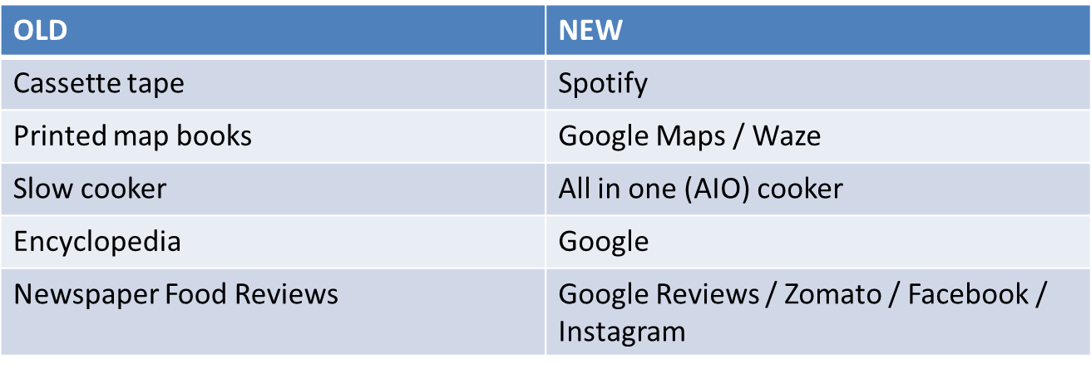
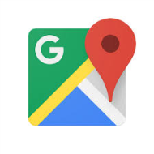
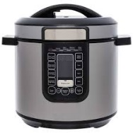
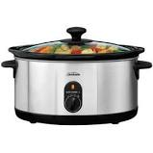

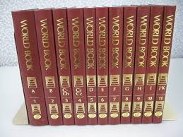
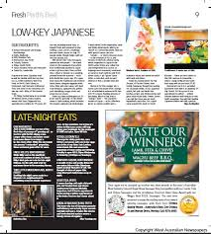

Everyday Old vs New Examples
Notes:
Here are some examples I have listed to show you some one and new examples we use everyday and won’t think twice about.
The good old cassette tape. I remember thinking to myself this is the best thing ever. But do you ever get to a point where you just listen to the same old thing on that cassette and think “Really, the same songs over and over again?” Compare it to Spotify now. At the touch of the search function you can listen to song you want to.
The next one was a life saver for Dino and I on our recent trip to Europe. Google Maps is best thing for any travel to a foreign land. I can’t count the number of times Google Maps helped us in our explorations (especially in Venice). In some countries, because they are pretty old (hundreds of years), street names which you would find on the traditional map books aren’t going to help you.
I’m sure this is relatable to most of you. How great technology has been to reduce cooking time; from hours making a herbal soup; to just 30 minutes.
The next one I was one that experienced both world in my schooling years. I only used the Encyclopedia in primary school and then Google came along in high school. The Encyclopedia would only get you so far, so then off to the library to borrow even more books for just 1 topic. Now all you do is open your Internet browser, type in what you would like to know and millions of different links appear for you.
The last one is one that speaks directly to me. I remember as a kid reading the food review sections and thinking to myself “Yum, I want to go eat this now” but as a kid you don’t have access to a lot of things, mainly transport and cash to try food at the said place. These days social media is the way to peoples stomachs. When we were over in Europe, Google Reviews helped us avoid restaurants with bad reviews be it in food and/or service; and not get the “Tourist trap restaurants.”
So why am I actually telling you all this? It’s to raise an awareness that what we thought was the “best and greatest” back in the day aren’t even given a 2nd look now.
So how does this relate to us Spiritually?

Slide 5
Questions I have asked myself over the course of my Christian life
I’m comfortable where I am, I don’t need to grow?
Only having an “experience once” is fine for my Christian walk!
I’ve been to many training classes/programs, what can I really benefit from going back and doing it again?
Notes:
I’m going to be completely open and transparent with you this morning.
These aren’t google default questions I typed in preparation for this message, but real questions I’ve asked myself throughout my Christian walk.
If you are completely honest with yourself, you may have asked similar questions.
Yesterday a few of us were at the Armadale4Jesus. I heard this quote and I will repeat it for you this morning. “Going to church doesn’t make you a Christian; just like sitting in McDonalds doesn’t make you a cheeseburger.” How true this is, it made me sit up at attention and reconsider my Christian walk. Was it a outward show? Or do I really have a personal relationship with God the Father, Jesus the Son and the Holy Spirit?
PRAYER: Heavenly Father, I come before you today and humble myself to say sorry, for making Christianity an outward show, but not a personal relationship with you, Jesus and the Holy Spirit. So today I purpose in my own heart that from this day onward I will build my life on the solid rock which is Jesus, I will walk and agree with what You say in Your Word. Thank you for this timely reminder and I declare resurrection life into everyone’s spirit, soul and body and into their mind will and emotion. That we are now alive in Christ Jesus and we will walk out different today. So Holy Spirit fill us afresh with fire from Heaven. In Jesus mighty name. Amen

Slide 6
What does new wine mean?
Wine is symbolic of the Holy Spirit
  Matthew 9:17
  Ephesians 5:18
    Infilling of the Spirit is compared and contrasted to drinking wine
  A new wine from Heaven!
    What is “new” tastes different
Notes:
Jesus spoke of it in association with the move of God.
Matthew 9:17 – “Nor do they put new wine into old wineskins, or else the wineskins are ruined. But they put new wine into new wineskins, and both are preserved.”
Ephesians 5:18 – And do not be drunk with wine, in which is dissipation (overindulgence); but be filed with the Spirit.
In order to appreciate new, you must clear yourself of the old.

Slide 7
What does new wine mean?
2. Speaks of renewed love and intimacy with God
  God is calling you back to your first love with Him
  Psalms 27:14
Notes:
Do you remember your first love with God?
In the busyness of life we have lost it. We go here, there and everywhere thinking we are being intimate with God; but He’s saying “Just stop, intimacy is not activity but relationship/encounter.”
Ps 27:14 – Wait on the Lord, Be of good courage, And He shall strengthen your heart; Wait, I say, on the Lord!

Slide 8
What does new wine mean?
3. New wineskins are needed for new wine
  Matthew 9:17
  “Flexible”
  Fresh
  To receive the new move of the Holy Spirit, we also need to be new (thinking, behaviours, actions)
Notes:
Matthew 9:17 – “Nor do they put new wine into old wineskins, or else the wineskins are ruined. But they put new wine into new wineskins, and both are preserved.”
Get rid of the mindset of limitation, I can’t do it because of this and that. God is no respecter of persons (Acts 10:34, Romans 2:11). He just wants your obedience to His Word.
Questions to ask:
What ways, means and methods are now being surpassed?
What new strategies does God want us to embrace, as we set into this “new” season?
What is the Holy Spirit saying?

Slide 9
Conclusion
If we want new, we must let go of the old (mindsets, limited thinking)
New wine comes from pressure and crushing of our old shelves.
Notes:
When Ps Joseph declares “resurrection life,” we can have a stock-standard response, just to receive because we are told to. But in this “new” season, it’s the inward that matters – do it so that your heart will truly please God.
As you respond to this, remember that you are saying to your spirit, soul and body ‘die’ as you allow the Holy Spirit to refine you to become more like Christ.
Out with the Old, In with the New
Prayer: In the mighty name of Jesus, your Word is ever living. So we commit our lives back to You, God. Let there truly be a transformation in our lives, starting from our inward man. So we declare right now true death of our lives, we need a fresh outpouring of Your Spirit, as we move into a new gear. In the name of Jesus I declare resurrection life right now into our spirit, soul and body, mind, will and emotion; let every old thing pass away and fill us afresh with the Holy Spirit. In Jesus might name. Amen.

